Slide 1
Bank Deposit Subscription Prediction Report
Team Smart Banker (Data Science Specialization)
April 26, 2023

Slide 2
Agenda
01. Meet the Team
02. Problem Description & Business Understanding
03 Data Types and Problems in the Data
04. Approach to Eliminate Problems in the Data
05. Recommended ML Models for the Business Problem
06. Predictions, Results and Evaluation
06. Reflection and Conclusion
07. Project Timeline

Slide 3

Meet the Team
Group Name: Team Smart Banker
Member Name: Chukwujekwu Joseph Ezema
Email: chukwujekwujeks@gmail.com
School: Teesside University Middlesbrough
Country: United Kingdom
Specialization: Data Science

Slide 4

Bank Marketing Campaign
A Data Science Project

Slide 5
Problem Description
Objective: Predict if a client will subscribe to a term deposit offered by a bank.
Dataset: Information related to direct marketing campaigns conducted through phone calls by a Portuguese banking institution.
Goal: Build a classification model that predicts whether the client will subscribe to the term deposit or not, based on various input variables such as age, job, marital status, education, etc

Slide 6
Business Understanding
Importance: Success of direct marketing campaigns depends on accuracy of targeting potential customers who are more likely to purchase the offered product..
Interest: This is to help a bank identify customers who are more likely to subscribe to a term deposit to optimize their marketing strategy and increase their chances of success while minimizing their costs..

Slide 7
Data Types and Problems in the Data
Data Type: The data was majorly dominated by Categorical Data types – which led to most of the them being converted to viable numeric types for ease of modelling for the Classification problem..
Problem:
1. White spaces in the columns were replaced by “;” thereby making the original data to contain one column instead of 21 columns
2. Some columns were not in their appropriate data types e.g. duration, campaign etc
3. Data contained 0 missing values but 12 duplicated records
4. There were outliers across the numerical columns
5. There is imbalance in the target class, y

Slide 8
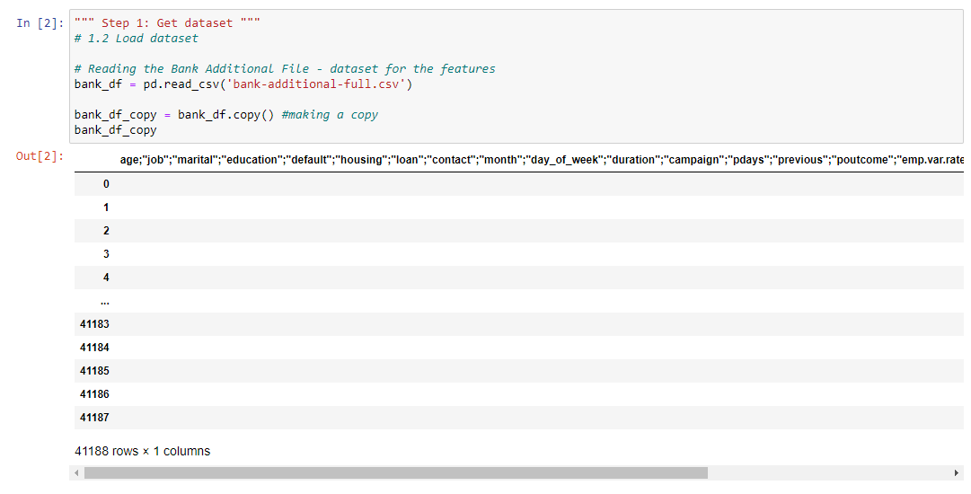
Original Data Load

Slide 9
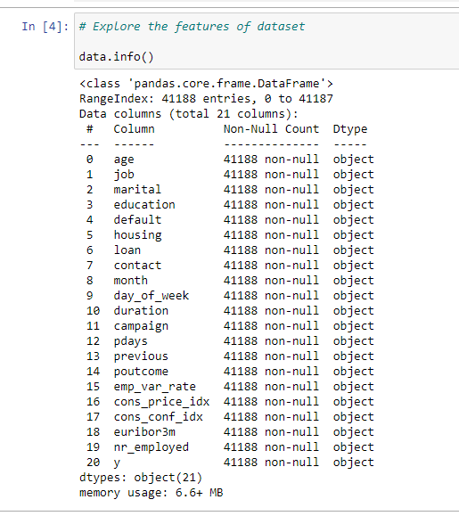
Inappropriate Datatypes

Slide 10
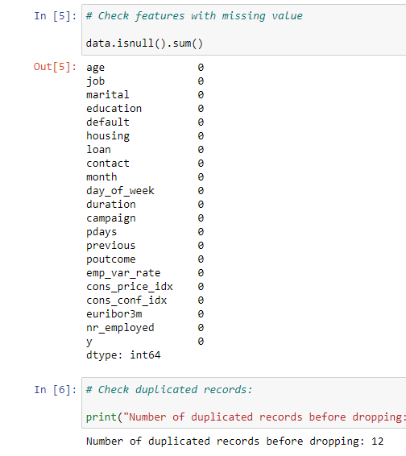
Missing & Duplicated Records

Slide 11
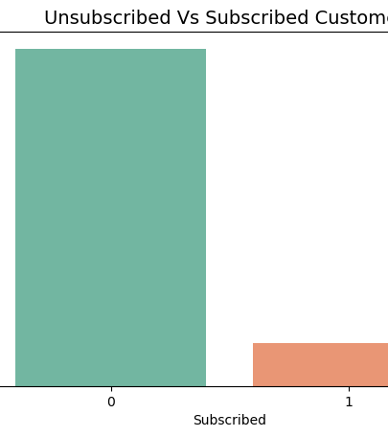
Imbalanced Target Class

Slide 12
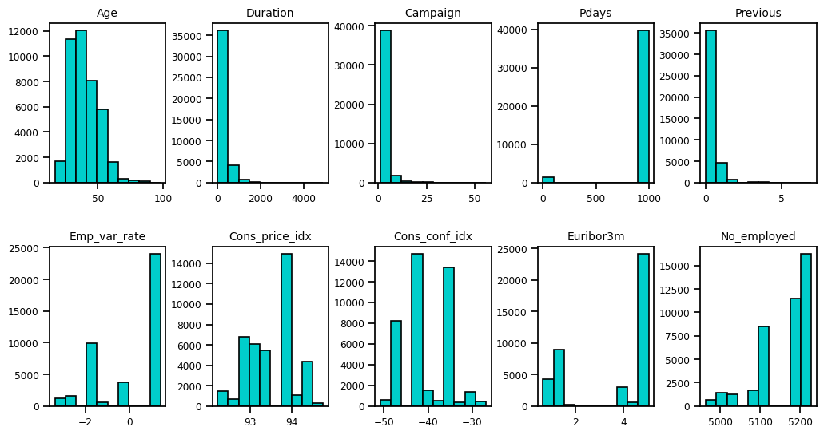
Outliers

Slide 13
Approach to Eliminate Problems in the Data
1. Split the columns using the delimiter, semicolon (;) and removed the double the quotes (“”)
2. Use methods from Pandas library to convert to appropriate datatypes e.g pd.to_numeric()
3. Dropped duplicated rows
4. Use StandardScalar() from sklearn package to limit the effects of the outliers
5. Use smote() oversampling technique from imblearn package to handle the imbalance so as not to lose possible data for the training and testing

Slide 14
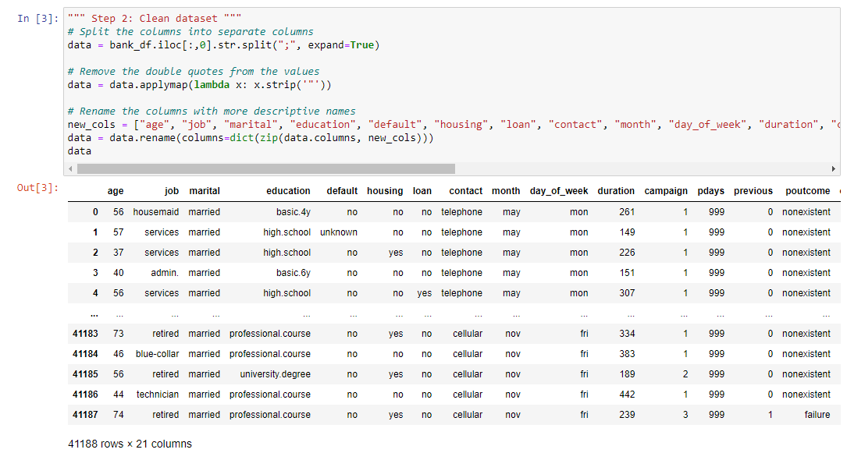
Cleaned Dataset

Slide 15
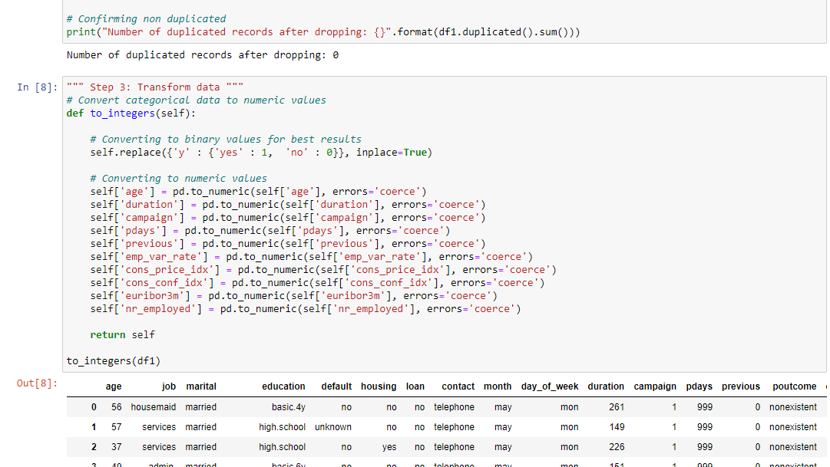
Dropped Duplicates and converted to numeric

Slide 16
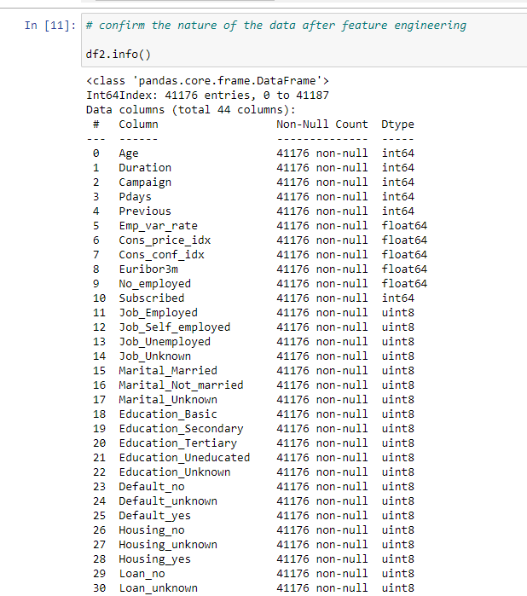
After Transformation
Cleaned the jam-packed columns into distinct columns
Removed duplicates
Converted wrong object datatypes to appropriate numerical types
Created a function to label encode and further applied one-hot encoding using pd.get_dummies to put the categories into 1’s and O’s in order to avoid biases
Note: The increased number of columns will be tackled with dimensionality reduction strategy like PCA

Slide 17
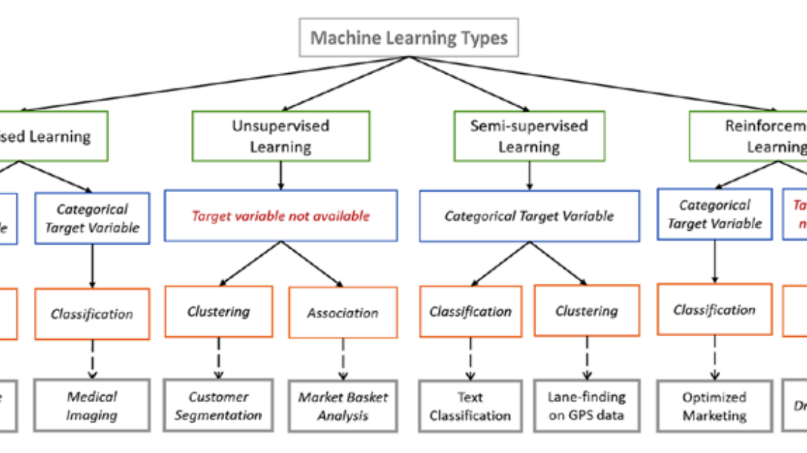
ML Models

Slide 18
ML Model Recommendations
1. Logistics Regression – Linear
2. K-Nearest Neighbour Classifier – Non-parametric
3. Random Forest Classifier - Bagging Ensemble
4. Gradient Boost Classifier - Boosting Ensemble
5. XGBoost Classifier - Boosting Ensemble
6. Neural Networks (Keras) for Deep Learning - Non-linear

Slide 19
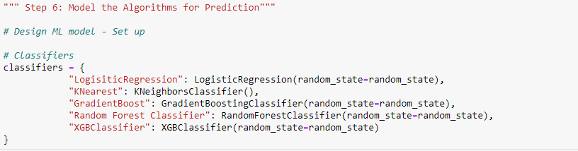
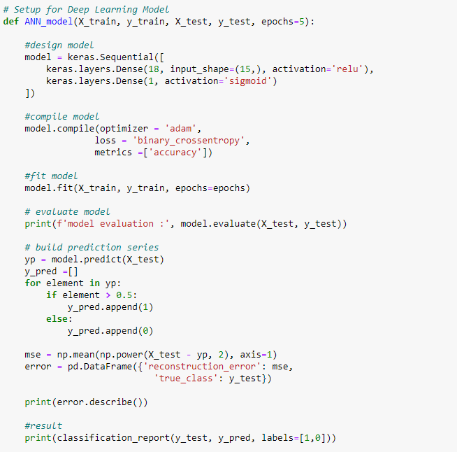
Why Choose them?
Logistics Regression: Linear model. Logistic regression is commonly used in classification problems because it provides a probabilistic interpretation of the outputs, allowing for easy thresholding for binary classification tasks. It can also handle imbalanced classes by adjusting the threshold for classification.
Gradient Boost Classifier: Ensemble model. Gradient boosting is a technique that combines multiple weak learners to create a strong learner. It can handle imbalanced data because it can assign more weight to the minority class during the boosting process
Neural Networks (Keras) for Deep Learning: Non-linear model. Neural networks are powerful models that can learn complex patterns in data. They can handle imbalanced data through techniques such as class weighting, oversampling of the minority class, and the use of specialized loss functions

Slide 20
Predictions, Results and Evaluation
Exp 1a: Classifiers on Best Features of Normal Sample Dataset (without oversampling)
Classifier | Accur. Score | Macro F1-Score | Weighted F1-Score | P-R Curve | AUC-ROC
Log. Regression | 0.87 | 0.80 | 0.86 | 0.75 | 0.93
KNN | 0.87 | 0.82 | 0.87 | 0.71 | 0.92
Gradient Boost | 0.89 | 0.85 | 0.89 | 0.78 | 0.94
Random Forest | 0.86 | 0.79 | 0.85 | 0.77 | 0.93
XG Boost | 0.89 | 0.85 | 0.89 | 0.79 | 0.94

Slide 21
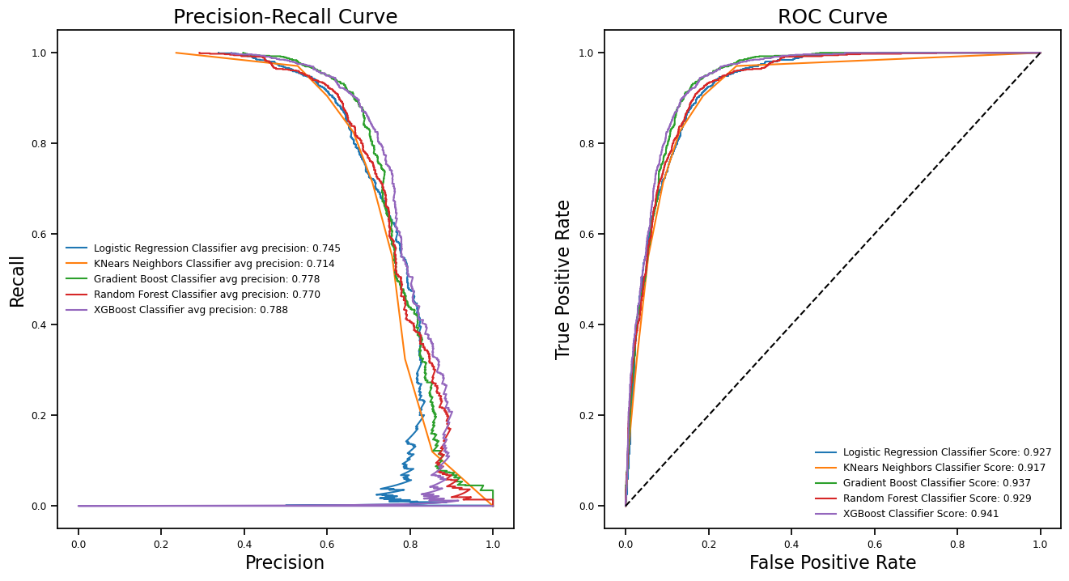
Exp 1a

Slide 22
Predictions, Results and Evaluation
Exp 1b: PCA applied on Normal Sample Dataset (without oversampling)
Classifier | Accur. Score | Macro F1-Score | Weighted F1-Score | P-R Curve | AUC-ROC
Log. Regression | 0.87 | 0.81 | 0.86 | 0.74 | 0.92
KNN | 0.86 | 0.80 | 0.85 | 0.68 | 0.89
Gradient Boost | 0.87 | 0.82 | 0.87 | 0.75 | 0.92
Random Forest | 0.85 | 0.76 | 0.84 | 0.73 | 0.91
XG Boost | 0.88 | 0.83 | 0.88 | 0.74 | 0.92

Slide 23
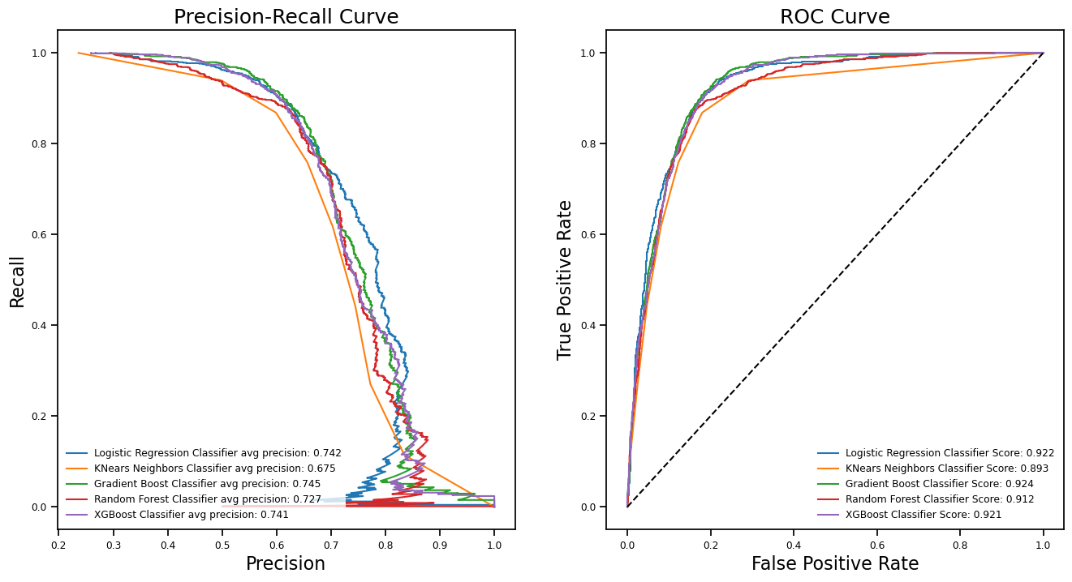
Exp 1b

Slide 24
Predictions, Results and Evaluation
Exp 2a: Smote Technique on Best Features - Oversampling
Classifier | Accur. Score | Macro F1-Score | Weighted F1-Score | P-R Curve | AUC-ROC
Log. Regression | 0.86 | 0.82 | 0.86 | 0.75 | 0.93
KNN | 0.85 | 0.82 | 0.86 | 0.69 | 0.91
Gradient Boost | 0.88 | 0.85 | 0.89 | 0.78 | 0.94
Random Forest | 0.84 | 0.81 | 0.85 | 0.77 | 0.93
XG Boost | 0.88 | 0.85 | 0.89 | 0.77 | 0.94

Slide 25
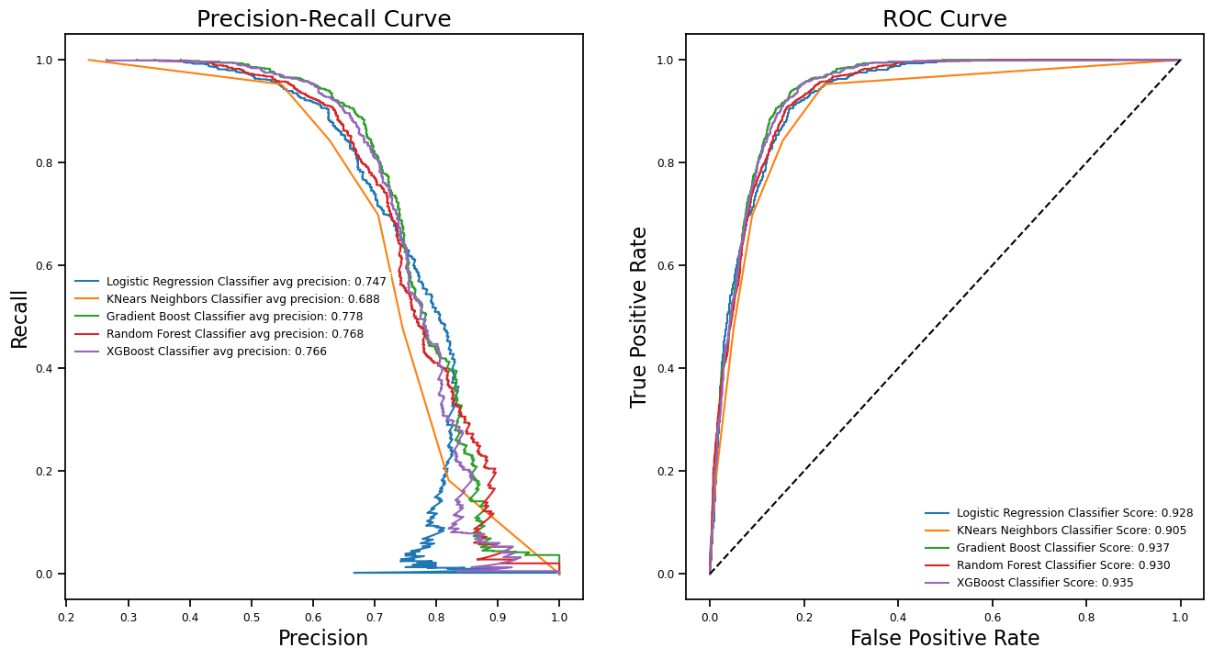
Exp 2a

Slide 26
Predictions, Results and Evaluation
Exp 2b: SMOTE Technique on PCA - Oversampling
Classifier | Accur. Score | Macro F1-Score | Weighted F1-Score | P-R Curve | AUC-ROC
Log. Regression | 0.86 | 0.82 | 0.86 | 0.74 | 0.92
KNN | 0.85 | 0.80 | 0.85 | 0.60 | 0.85
Gradient Boost | 0.87 | 0.83 | 0.87 | 0.75 | 0.93
Random Forest | 0.83 | 0.80 | 0.84 | 0.74 | 0.92
XG Boost | 0.87 | 0.83 | 0.87 | 0.74 | 0.92

Slide 27
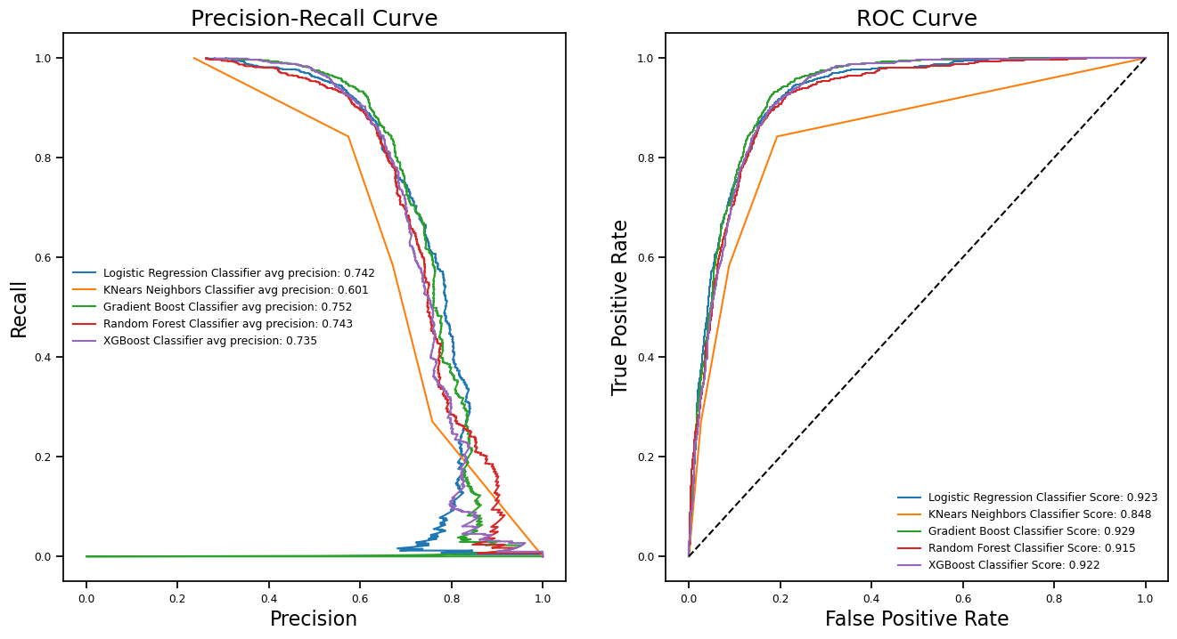
Exp 2b

Slide 28
Predictions, Results and Evaluation
Exp 3a/3b: Artificial Neural Network Classification Model
Sample | Accur. Score | Macro F1-Score | Weighted F1-Score | P-R Curve | AUC-ROC
Best Features | 0.87 | 0.82 | 0.87 | 0.63 | 0.81
SMOTE Sample | 0.86 | 0.83 | 0.87 | 0.66 | 0.85

Slide 29
Reflection and Conclusion
This project was to build a classification model, at least one from a family of algorithm, that predicts whether clients will subscribe to the term deposit or not, based on various input variables such as age, job, marital status, education etc. The dataset was properly cleaned and preprocessed. To reduce training time, a resampling was carried out, this was also to reduce the adverse effect of imbalance in the data. The data were scaled using StandardScaler. The feature selection technique proved to be quite good on the models, with less impact by SMOTE techniques and PCA feature selection.
GridSearchCV was used to get the best-fit parameters on each of the models, which was evident in the model evaluation of 70 to 90% at almost all levels. The results from the different experiments and classification models didn’t show much differences except the impacts by ensemble boosting models. In conclusion, the prediction was a success as proper machine learning workflow was followed for a better result. The imbalanced dataset was handled by resampling technique – which can heavily affect model evaluation. Thus, these steps are highly recommended for classification problems.

Slide 30
Project Timeline
Wk1. 19 Mar – 26 Mar 2023
Wk2. 26 Mar – 2 Apr 2023
Data Collection: Download the dataset from the given source and load it into a Jupyter notebook.
Data Exploration: Perform preliminary data exploration to understand the dataset's structure, quality, and potential challenges.
Data Preparation: Prepare the dataset for modeling by performing data cleaning, feature selection, feature engineering, and data transformation as necessary.
Modeling: Train different classification models on the prepared dataset and evaluate their performance using appropriate metrics.
Wk3. 2 Apr – 9 Apr 2023
Wk4. 9 Apr – 16 Apr 2023
Model Tuning: Tune the hyperparameters of the best-performing model to improve its performance further.
Model Interpretation: Interpret the trained model and identify the most significant factors that contribute to the prediction.
Finalize the project report: Create a comprehensive report documenting the entire project, including problem definition, methodology, results, and interpretation.
Submission: Submit the final report within 2 weeks by April 28, 2023, as per the given deadline..

Slide 31

Thank you
Thanks for going through this interesting journey with us.
We hope we have added value to this work.
GitHub Link
https://github.com/Jeks042/Data-Science-Projects

